Slide 1
INSTITUTE FOR ADVANCED COMPUTING AND SOFTWARE DEVELOPMENT AKURDI, PUNE Documentation On “Event Management System” PG-DAC MARCH 2022
SUBMITED BY :
BIKKAD MANGESH SUNIL(223037)
GEETIKA KUMARI(223064)

Slide 2
Contents:-
TECHNOLOGY DESCRIPTON(Spring Boot(Java),MySQL,ReactJs)
FEATURES
SPECIFICATIONS
H/W & S/W REQUIREMENTS
DATA FLOW CHART
INTRODUCTION(PROJECT)
FLOW CHART
DFD
ER Diagram
SNAP SHOT
FUTURE SCOPE
COCLUSION

Slide 3
Technology Description
Java is an object-oriented programming language developed by Sun Microsystems, and it was released in 1995.
James Gosling initially developed Java in Sun Microsystems .
Java is a set of features of C and C++. It has obtained its format from C, and OOP features from C++.
Java programs are platform independent which means they can be run on any operating system with any processor as long as the Java interpreter is available on that system.
Java code that runs on one platform does not need to be recompiled to run on another platform; it's called write once, run anywhere(WORA).
Java Virtual Machine (JVM) executes Java code, but it has been written in platform-specific languages such as C/C++/ASM, etc. JVM is not written in Java and hence cannot be platform independent, and Java interpreter is a part of JVM.

Slide 4
Features of Java
Object-Oriented - Java supports the features of object-oriented programming. Its object model is simple and easy to expand.
Platform independent - Java application programs written in one Operating system can able to run on any Operating system.
Secure - Java provides a wide range of protection from viruses and malicious programs. It ensures that there will be no damage and no security will be broken.
Portable - Java provides us with the concept of portability. Running the same program with Java on different platforms is possible.
Robust - During the development of the program, it helps us to find possible mistakes as soon as possible.
Multi-threaded - The multithreading programming feature in Java allows you to write a program that performs several different tasks simultaneously.
Distributed - Java is designed for distributed Internet environments as it manages the TCP/IP protocol.

Slide 5
Object Oriented
Platform Independent
Simple & Secure
Portable & Robust
Multi-Threaded
Distributed

Slide 6
Specifications:-
Front End : ReactJs
Back End : Spring Boot(Java)
Database : MySQL

Slide 7
Frontend-ReactJs
React is a library which is developed by Facebook are utilized to implement the frontend.
React (also known as React.js or ReactJS) is a free and open-source front-end JavaScript library for building user interfaces or UI components.
It helps to create impressive web applications that require minimal effort.
It also improve the speed of the application.
We can also reuse the code whenever required.
It offers a scope where the developer can test and debug their codes with the help of native tools.

Slide 8
Backend-Spring-Boot
This is used to connect MYSQL and fetch data from database and store the data in database.
It provide default configuration to build spring powered framework.
There is no need to build config. manually and no requirement for a deployment descriptor.
It avoids boilerplate and wraps the dependencies together in a single unit.
It reduces development time and increases productivity.

Slide 9
Database-MySQL
It is a very powerful program in its own right. It handles a large subset of the functionality of the most expensive and powerful database packages.
MySQL uses a standard form of the well-known SQL data language.
It works on many operating systems and with many languages including PHP, PERL, C, C++, JAVA, etc.
It works very quickly and works well even with large data sets.
It is very friendly to PHP, the most appreciated language for web development.
It supports large databases, up to 50 million rows or more in a table. The default file size limit for a table is 4GB, but you can increase this (if your operating system can handle it) to a theoretical limit of 8 million terabytes (TB).
It is customizable. The open-source GPL license allows programmers to modify the MySQL software to fit their own specific environments.

Slide 10
H/W & S/W Requirements
Software Requirements
Platform Specification - Apache Server
Application Language-Java(Core)
Operating System – Windows XP or above Version
STS as IDE
MySQL Database
Hardware Requirements
256 MB RAM or above.
Processor-Pentinum IV with 1.8 MHz and above
Hard Disc-HDD(7GB and above).
Basic Terminal Device.

Slide 11
Introduction:-
In the event management system, user and admin can login , and vendors who provide services, can login using phone number. Users Select services, select event venue, date, no. of services and proceed for Billing. user can give ratings and feedback. Vendors can sign up as well. Vendors will have to fill their name, contact no. Admin can accept or reject or delete vendors. All the entities can logout. Vendor can update its information.

Slide 12
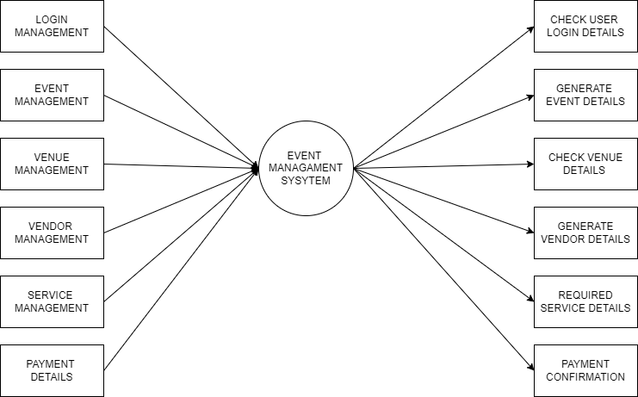
DATA FLOW DIAGRAM(DFD)

Slide 13
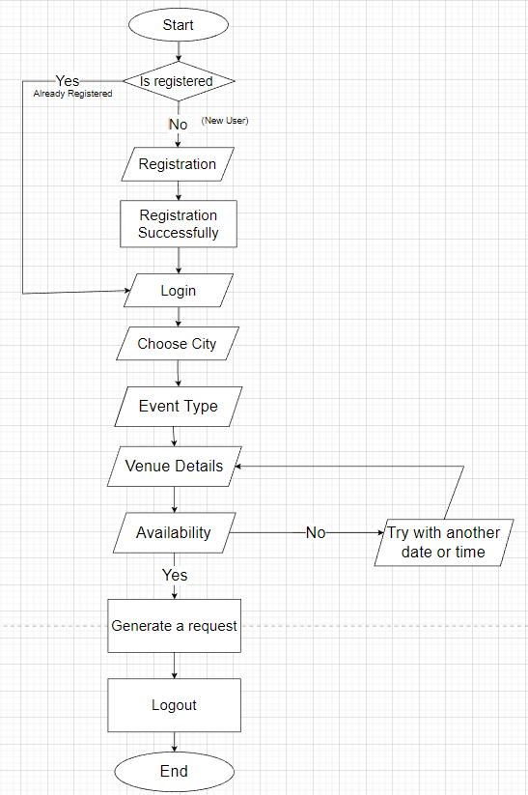
FLOWCHART

Slide 14
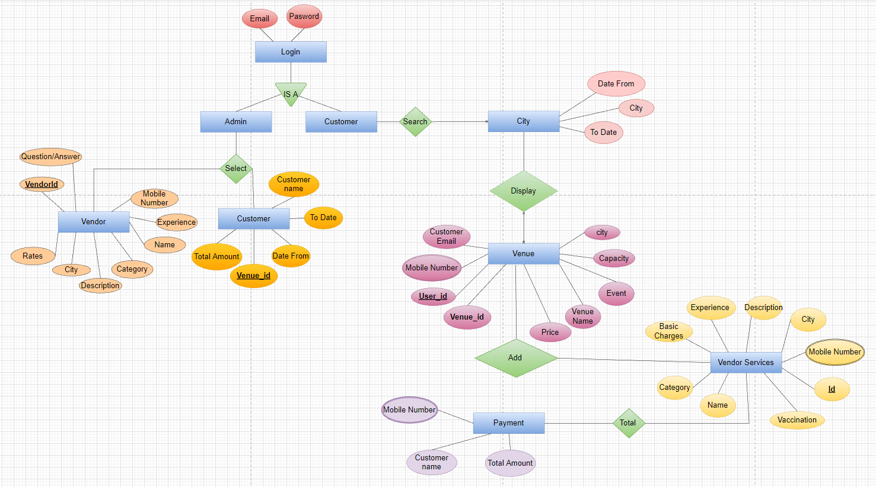
ER Diagram

Slide 15
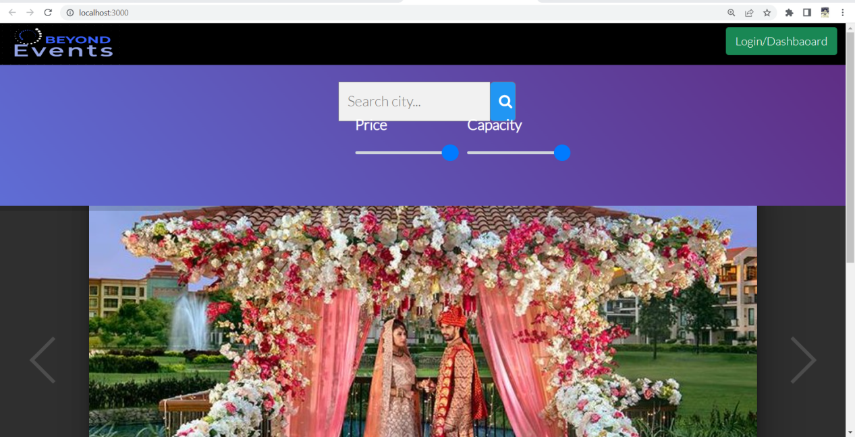
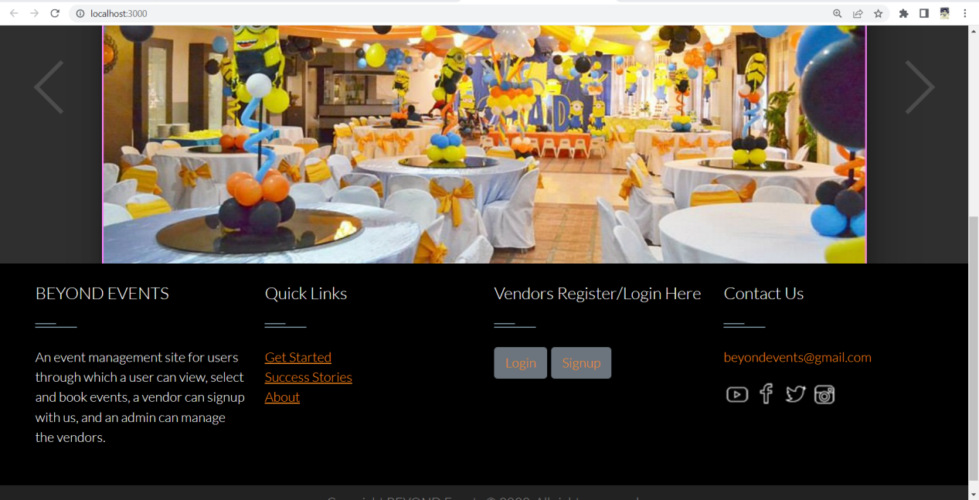
SNAPSHOT:-
Home Page:-

Slide 16
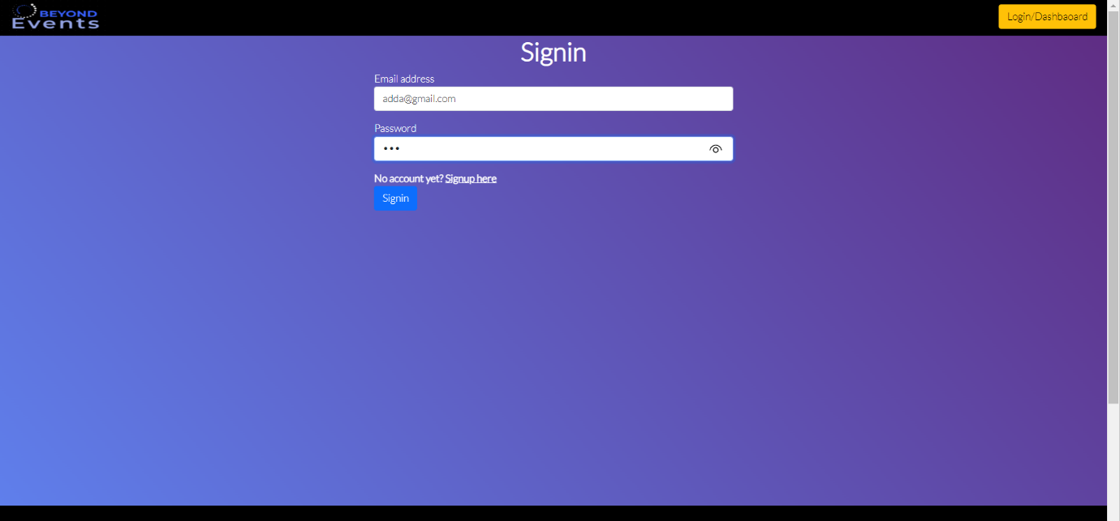
User/admin login:- If login correctly , choose for city:-

Slide 17
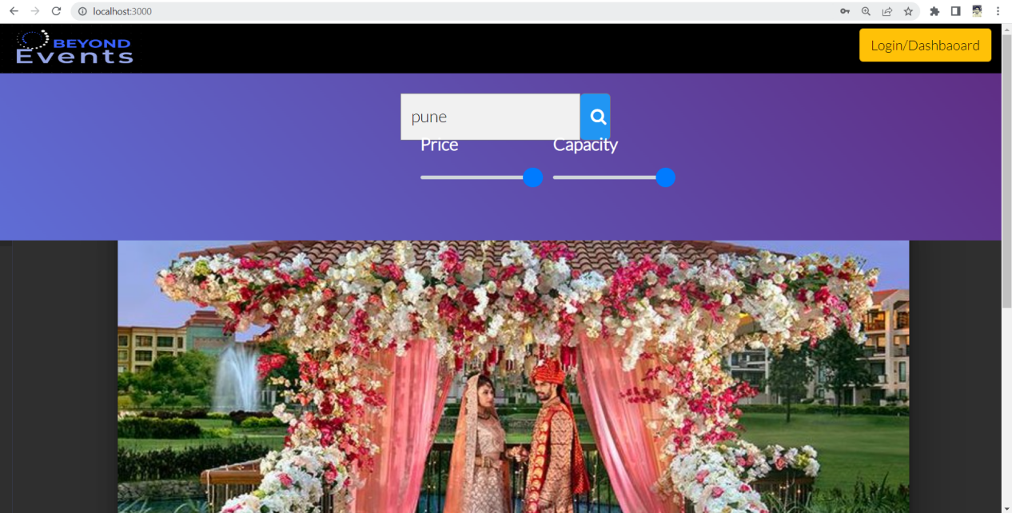
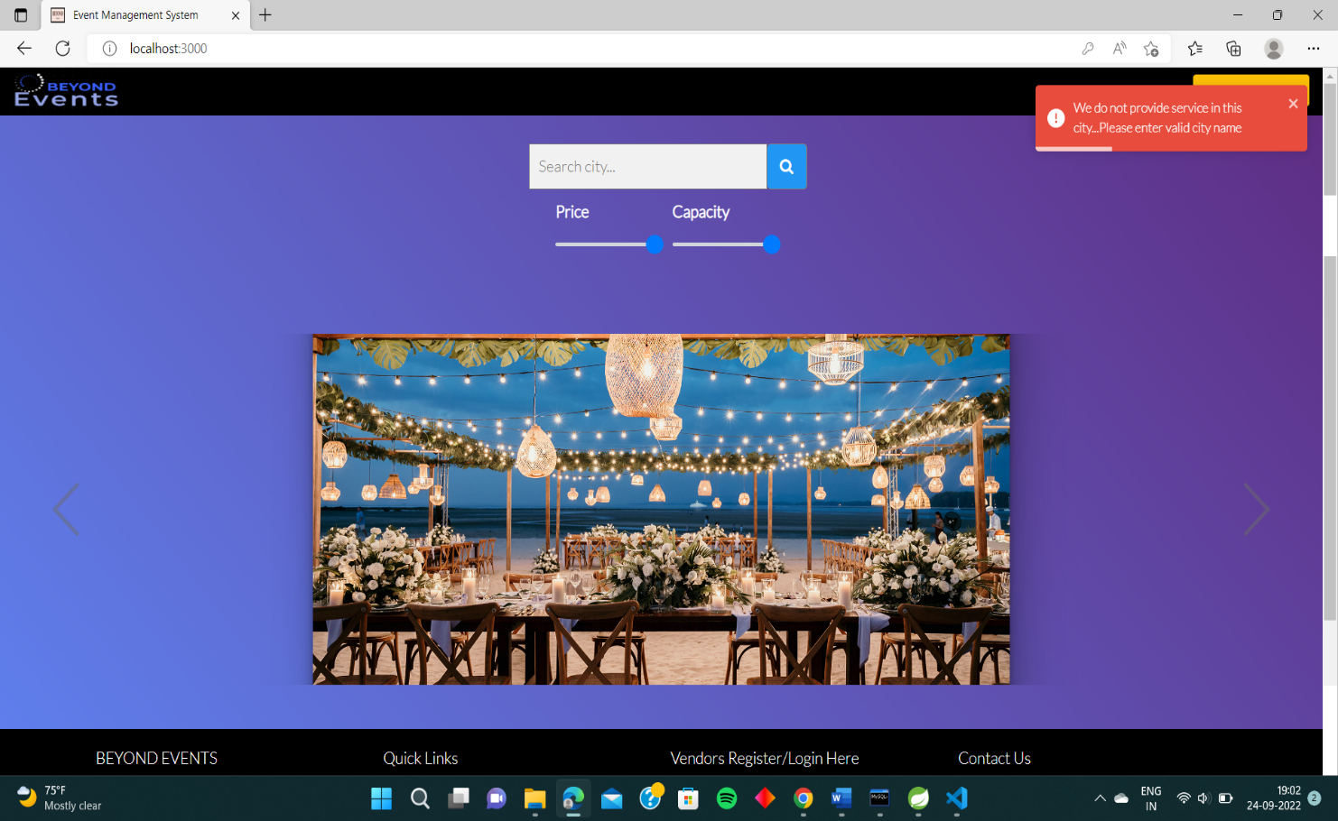
Choosing city(if present):-
Choosing city(if not present):-

Slide 18
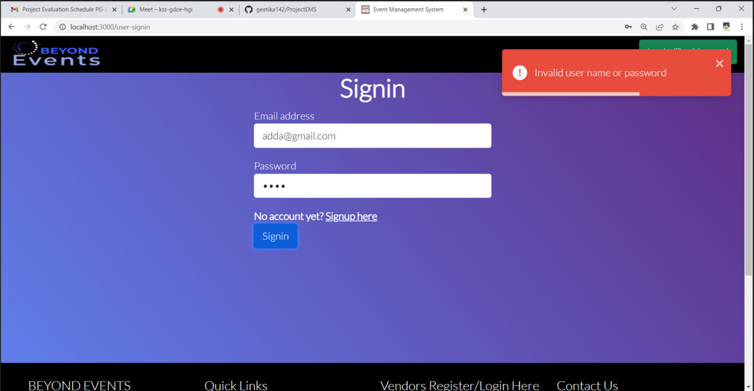
If login details are incorrect:-

Slide 19
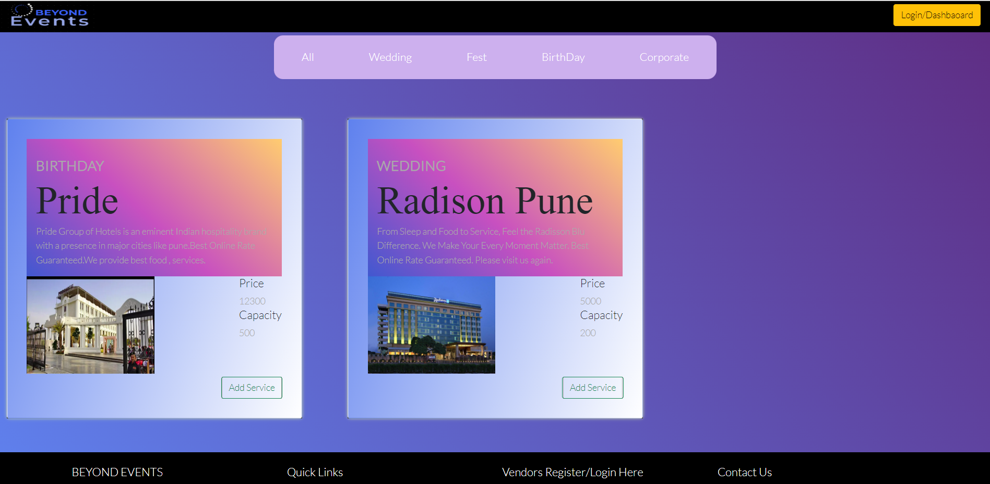
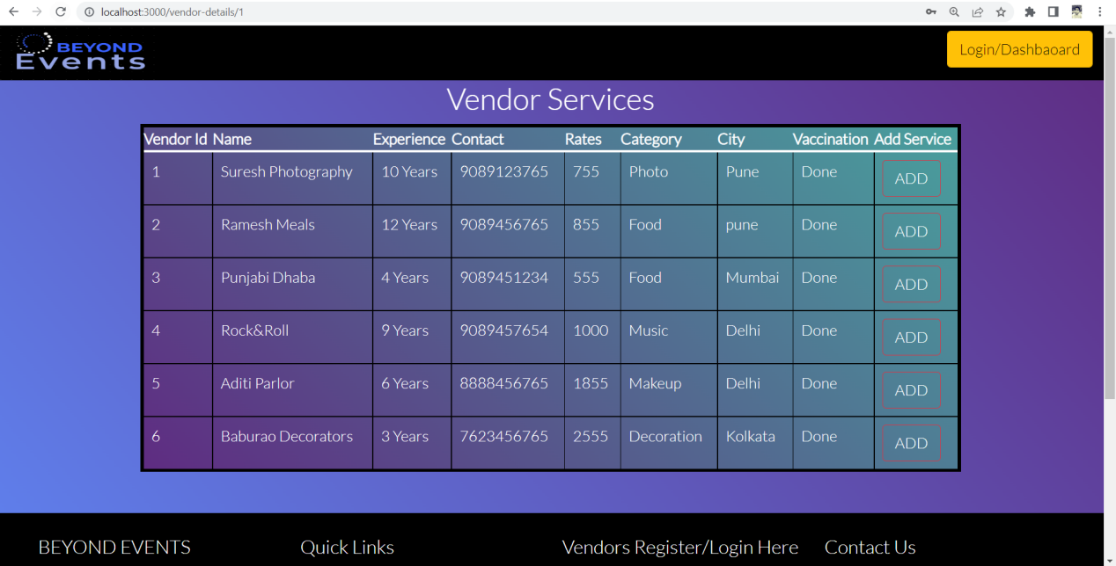
User can select any event according to needs:-
Select any Service:-

Slide 20
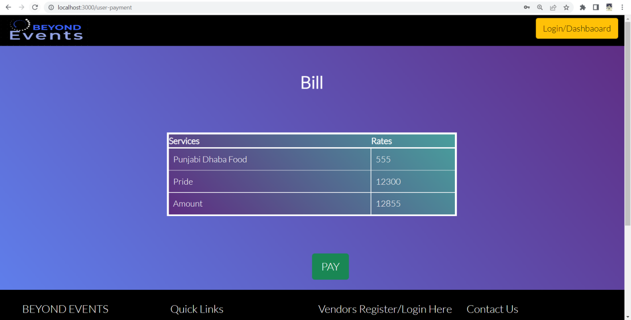
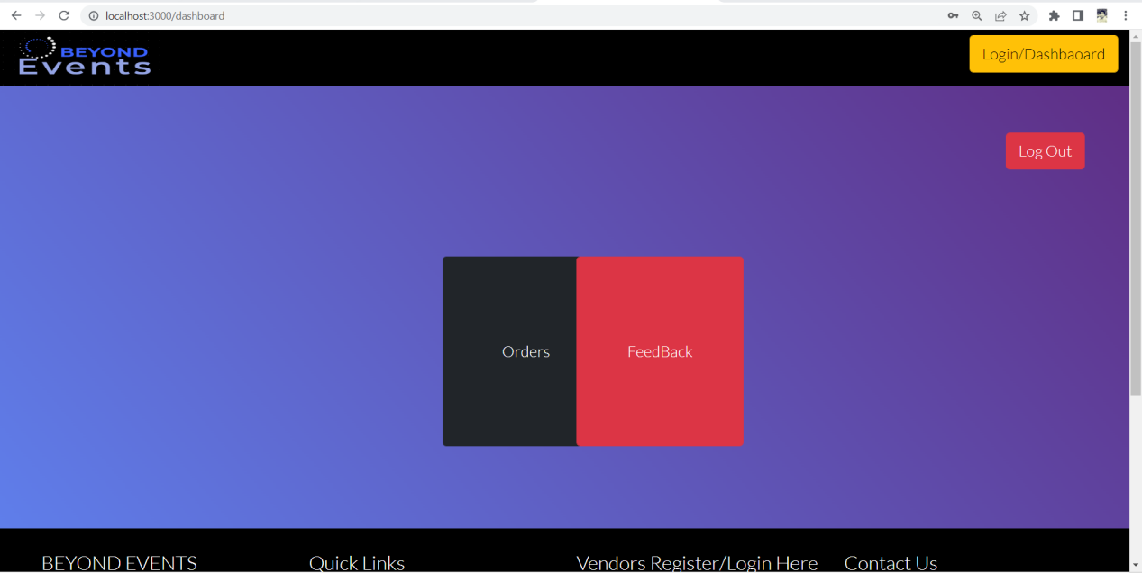
Total Bill:-
Feedback/Orders Page:-

Slide 21
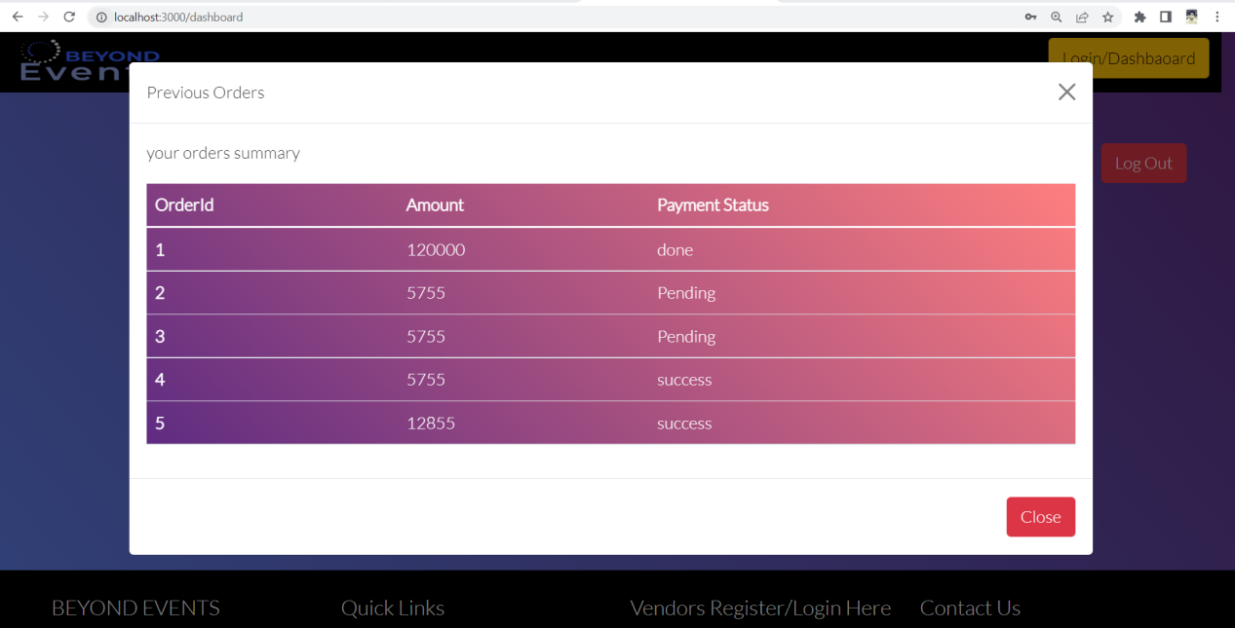
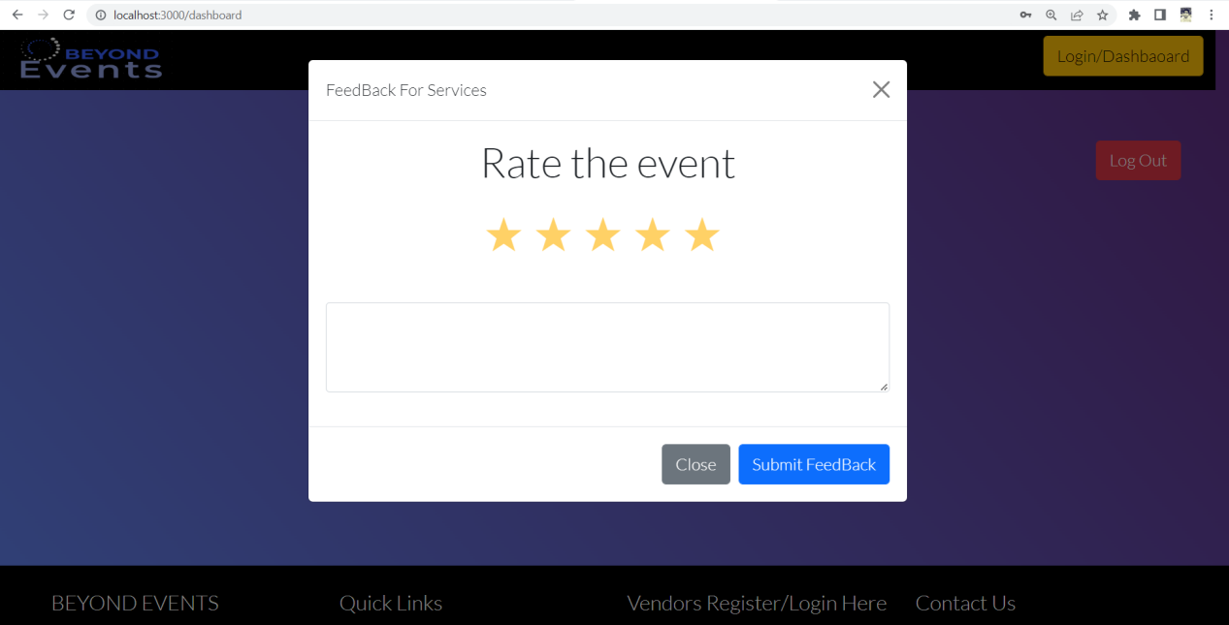
Order Summary:-
Feedback:-

Slide 22
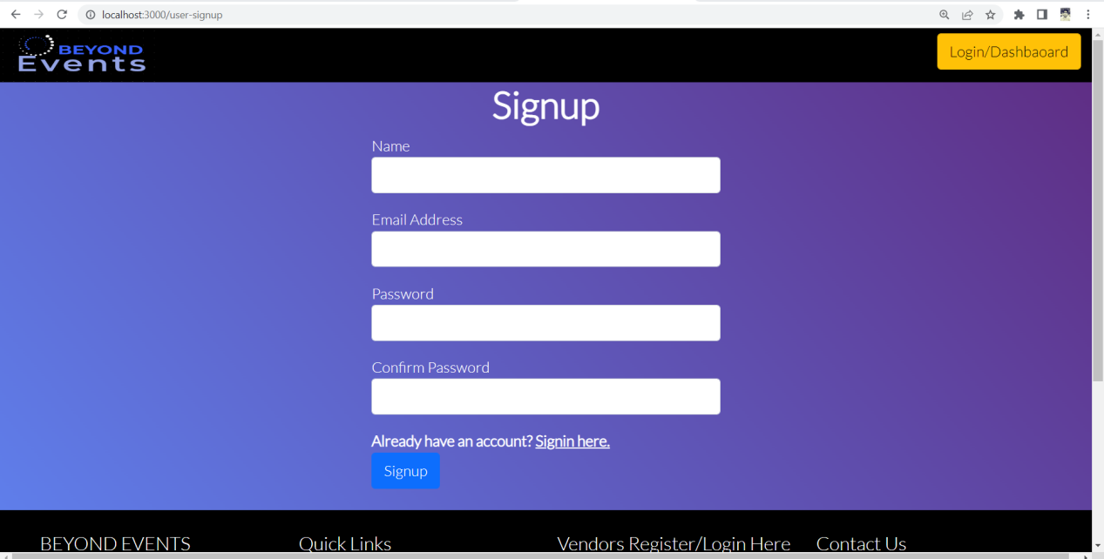
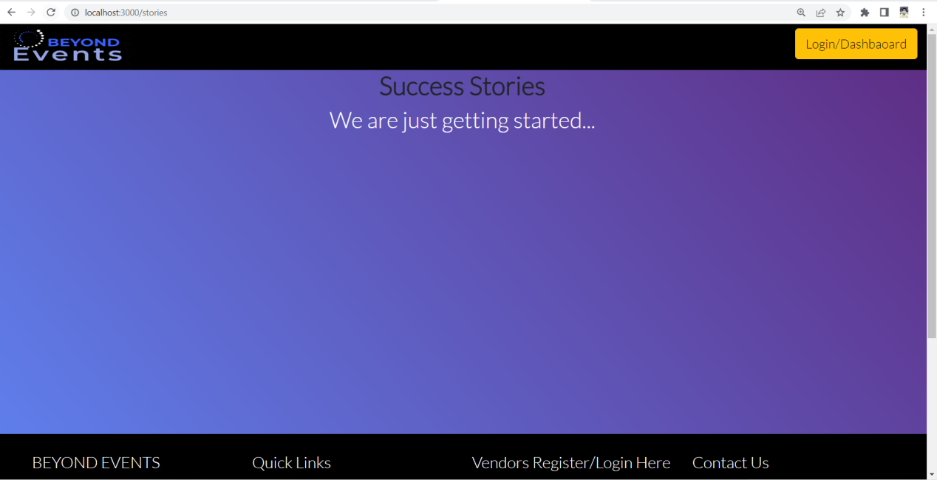
Add New User:-
Story:-

Slide 23
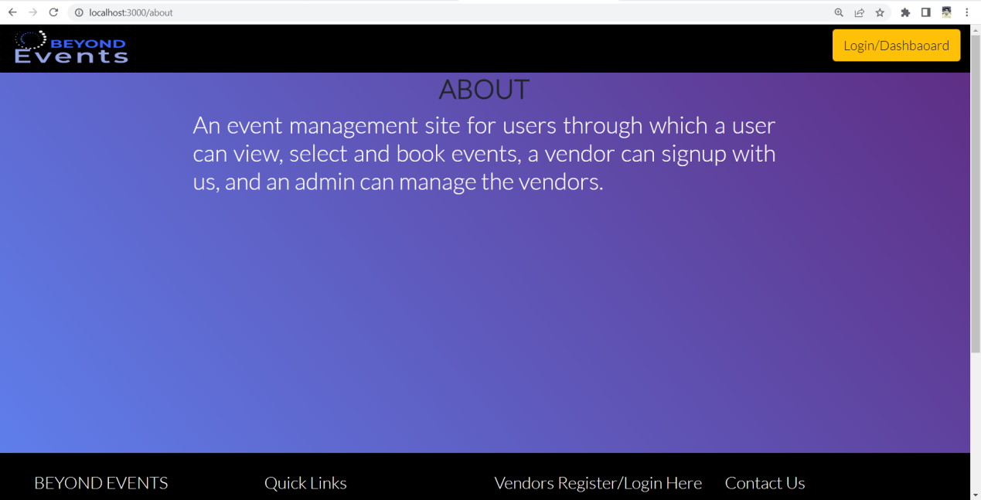
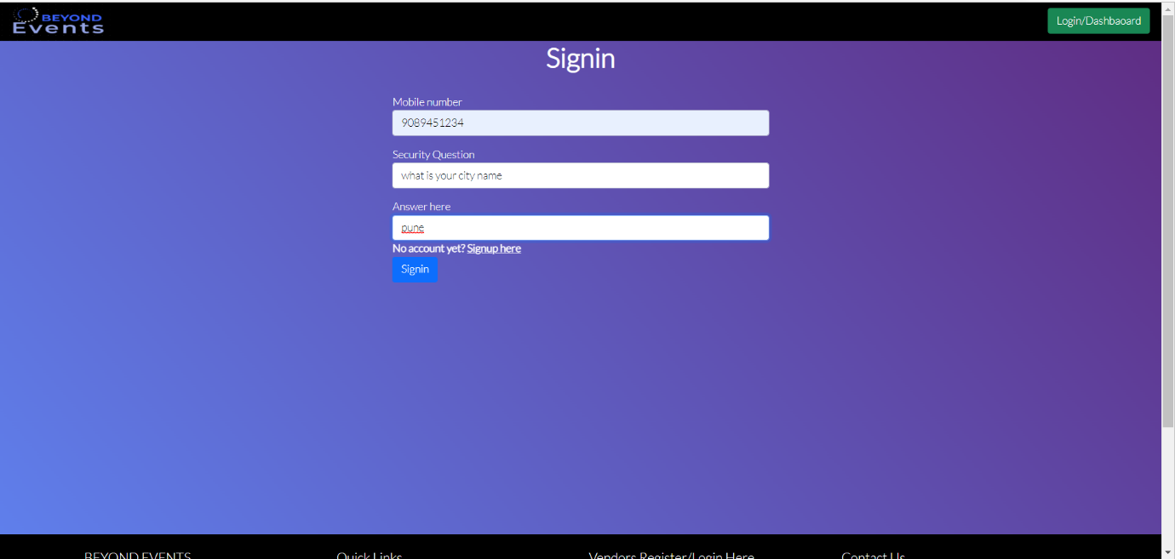
About:-
Vendor Login:-

Slide 24
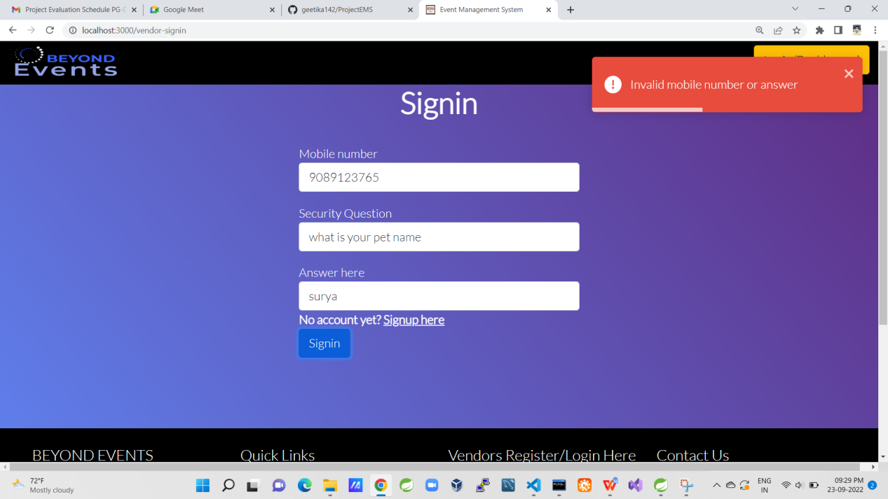
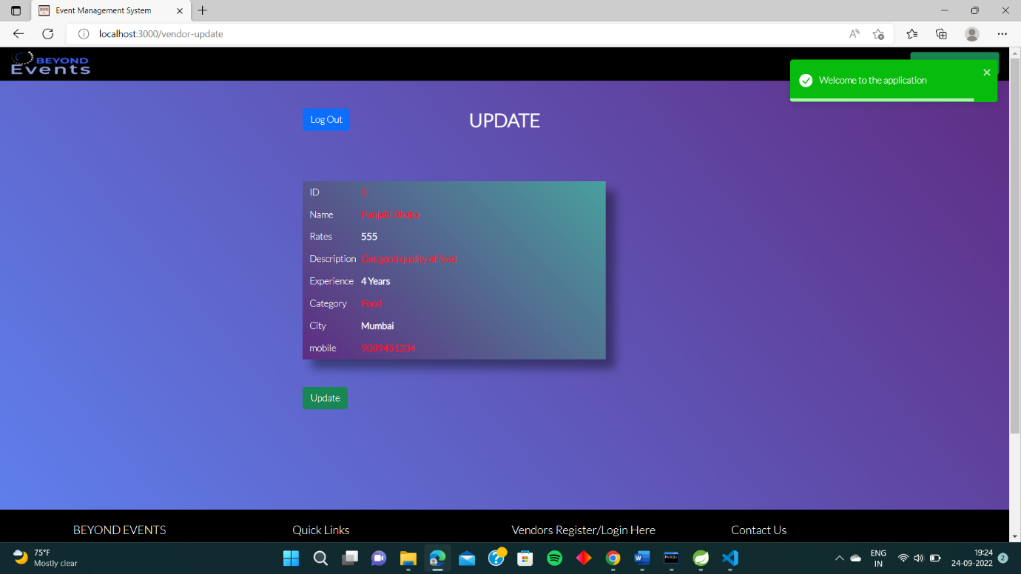
Vendor try to login in with wrong credentials:-
Vendor Details:-

Slide 25
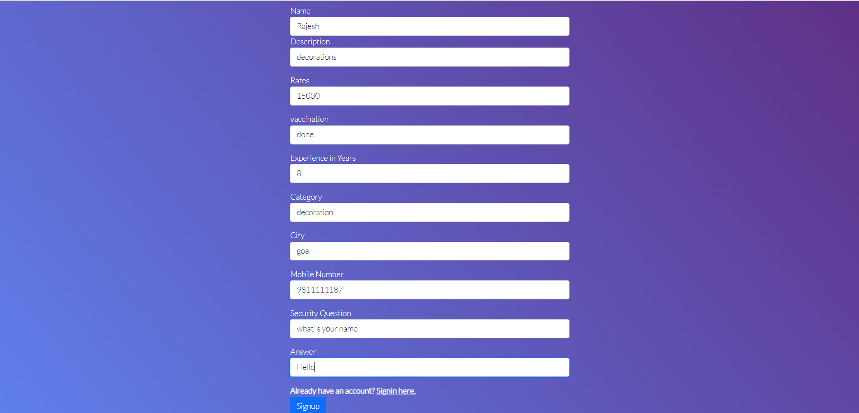
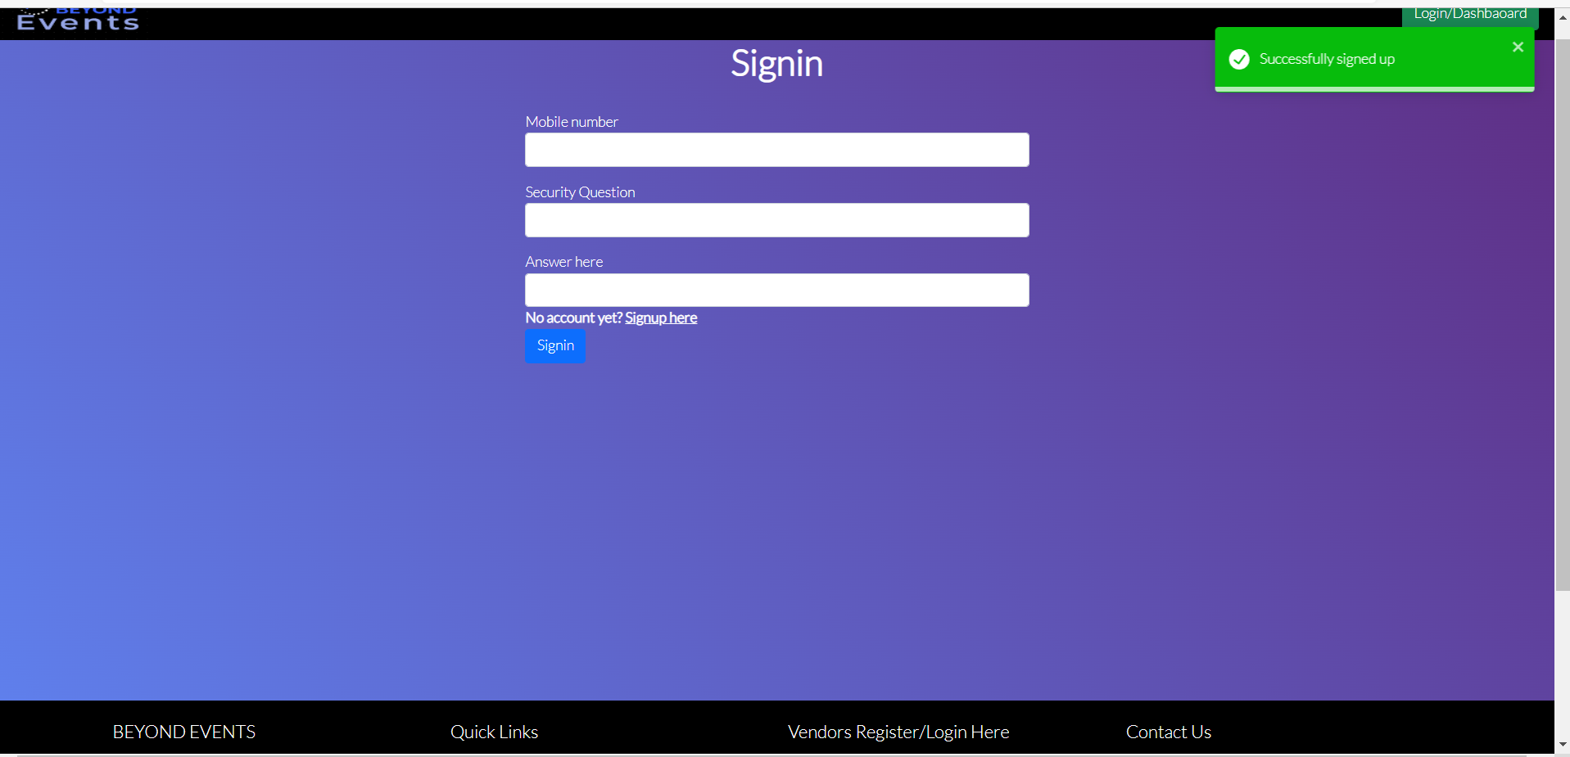
New Vendor:-
New Vendor Registered:-

Slide 26
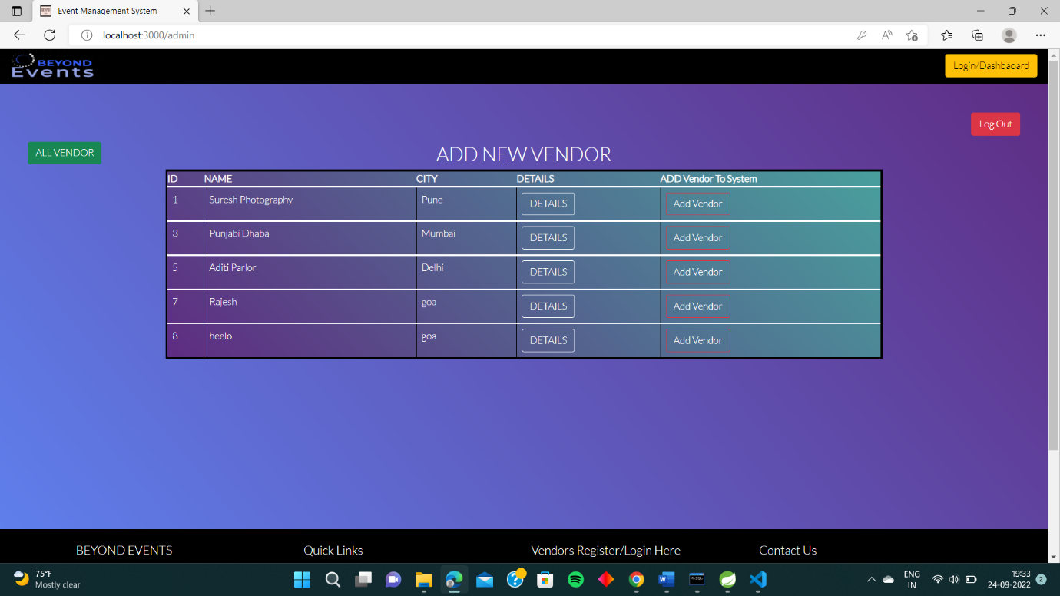
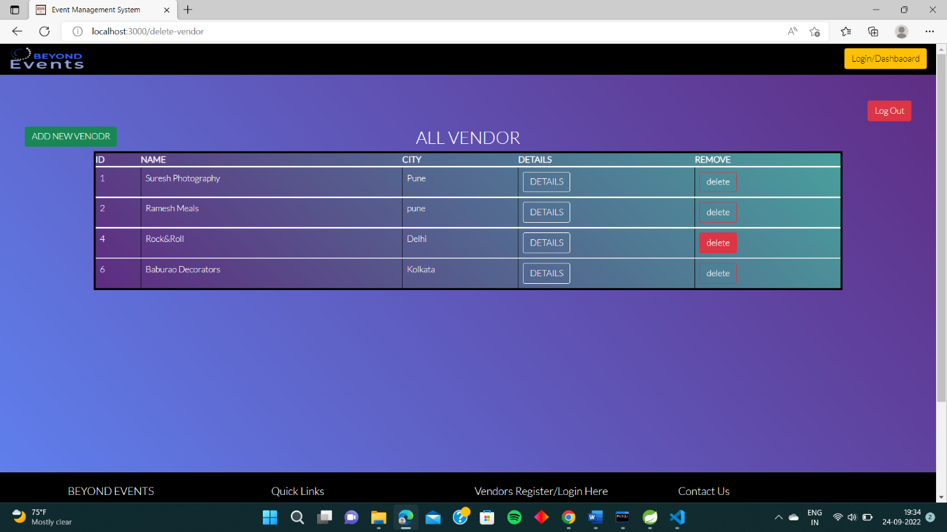
Admin Page(add vendor):-
Added Vendor By the Admin:-

Slide 27
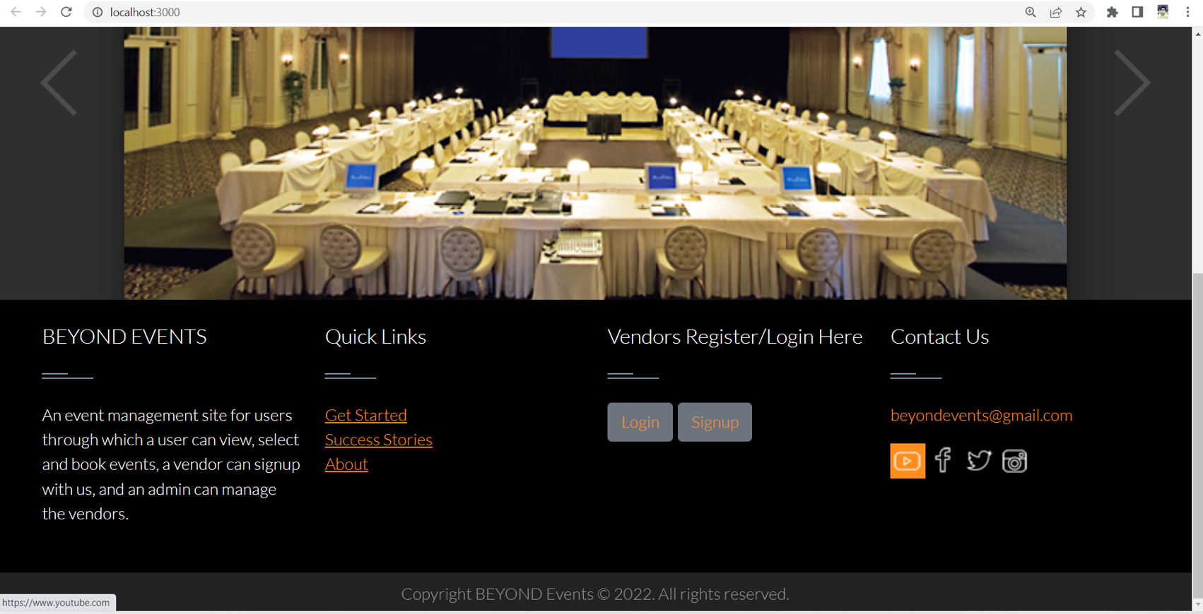
Sign of twitter/fb/youtube will open that page:-

Slide 28
FUTURE SCOPE:-
There is a scope for further development in our project to a great extent. A number of features can be added to this system in future like adding events like seminar, awards show etc and adding multiple services to the events and search event by date too. Another feature we wished to implement was providing subscribed user 5% off.
These features could have implemented unless the time did not limit us.

Slide 29
CONCLUSION:-
Event management is a glamorous and exciting profession which demands a lot of hard work and dynamism. As the name suggests, it means conceptualizing, planning, organizing and finally executing an event. The event could be of any type – wedding, birthdays, fests etc. This industry is just eight years old in India, but holds a lot of promise for expansion. It offers enormous scope for ambitious young people. Event management is the planning and implementation of events, large and small that meet the marketing goals of an organization. Event management is an area that is growing rapidly, and is expected to have a better growth rate in the next decade. Typical events organized by professional event managers include product launches, parties, sponsored events, sporting events, competitions, concerts and festivals, fundraisers, trade shows, corporate open days, seminars.
There is a scope for further development in our project to a great extent. A number of features can be added to this system in future like adding events like seminar, awards show etc and adding multiple services to the events and search event by date too. Another feature we wished to implement was providing subscribed user 5% off.
These features could have implemented unless the time did not limit us.

Slide 30
Thank you

